Slide 1
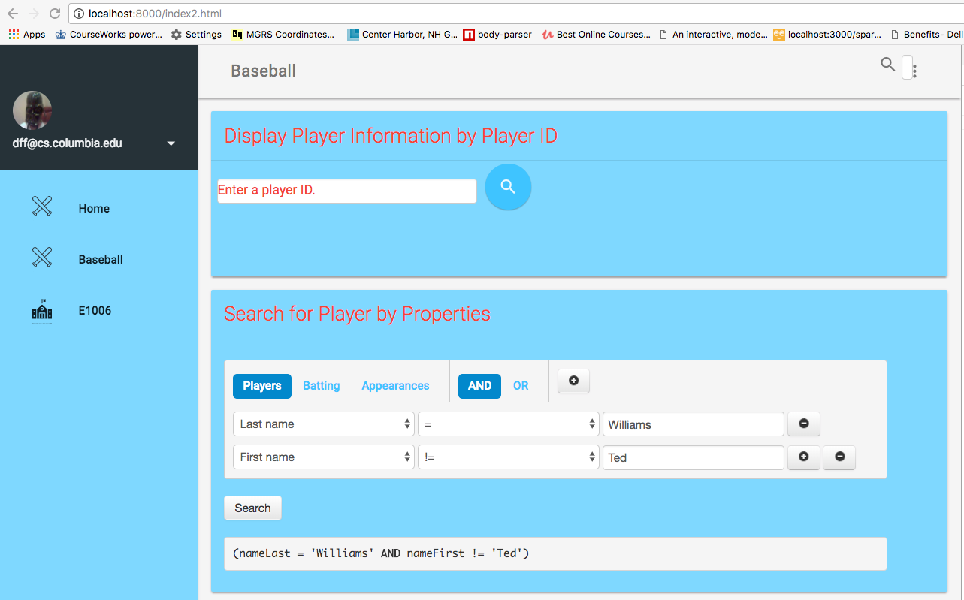
Enter playerID
Maps to GET /api/players/<value>
Enter <column><OP><value>
Maps to GET /api/players?<query>
Choose
Resource

Slide 2
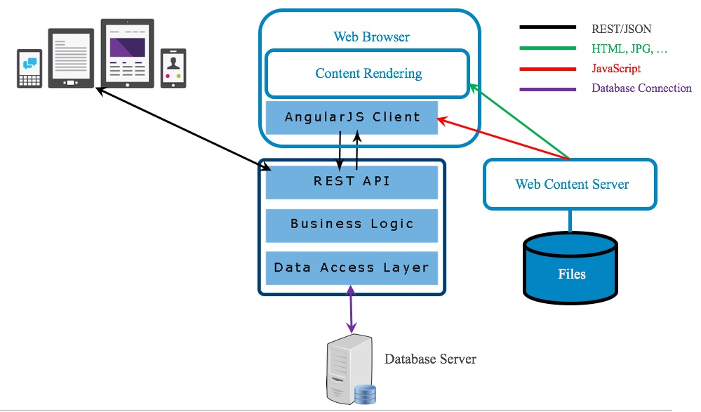
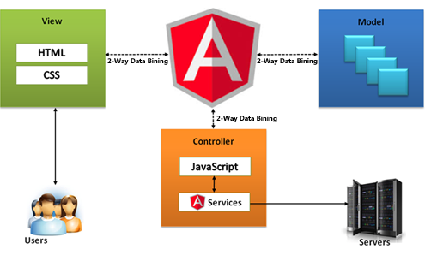
Primary
Focus

Slide 3
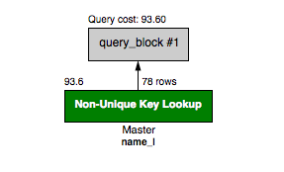
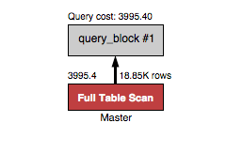
The query that uses an index is 50x more efficient in this example.
SELECT
nameLast, nameFirst
FROM
Master
WHERE
nameLast='Williams';
SELECT
nameLast, nameFirst
FROM
Master
WHERE
nameLast='Williams';

Slide 5
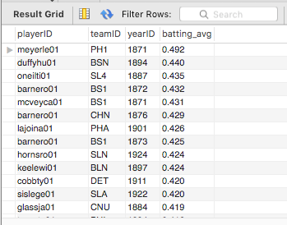
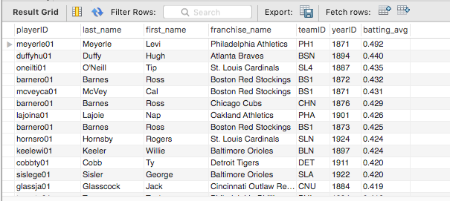
SELECT and PROJECT on Batting
But, I really want the names. Why not store them also?

Slide 6
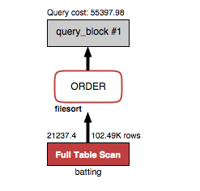

Slide 7
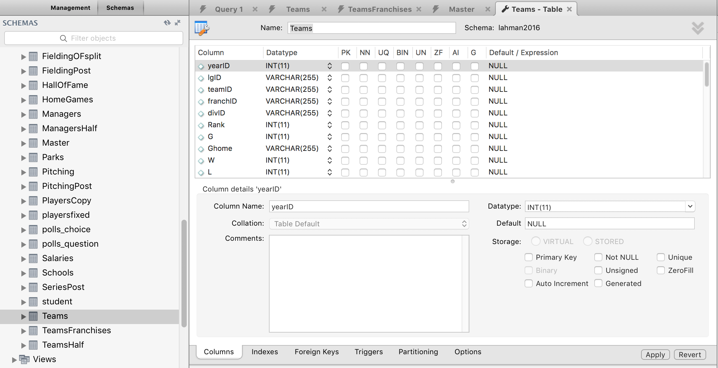
Column constraints
Right click
Alter table.
Type of constraint to define/change.

Slide 8
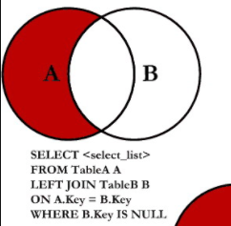
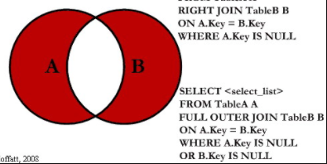
A = Master, B = AwardsPlayers
Set difference is Players that did not win an award.
UNION – INTERSECTION is
Players and each Award the player did not win.
What if I only want to know the players who did not win and Award but do not care about which one?
SELECT DISTINCT and do not choose awardID.

Slide 9
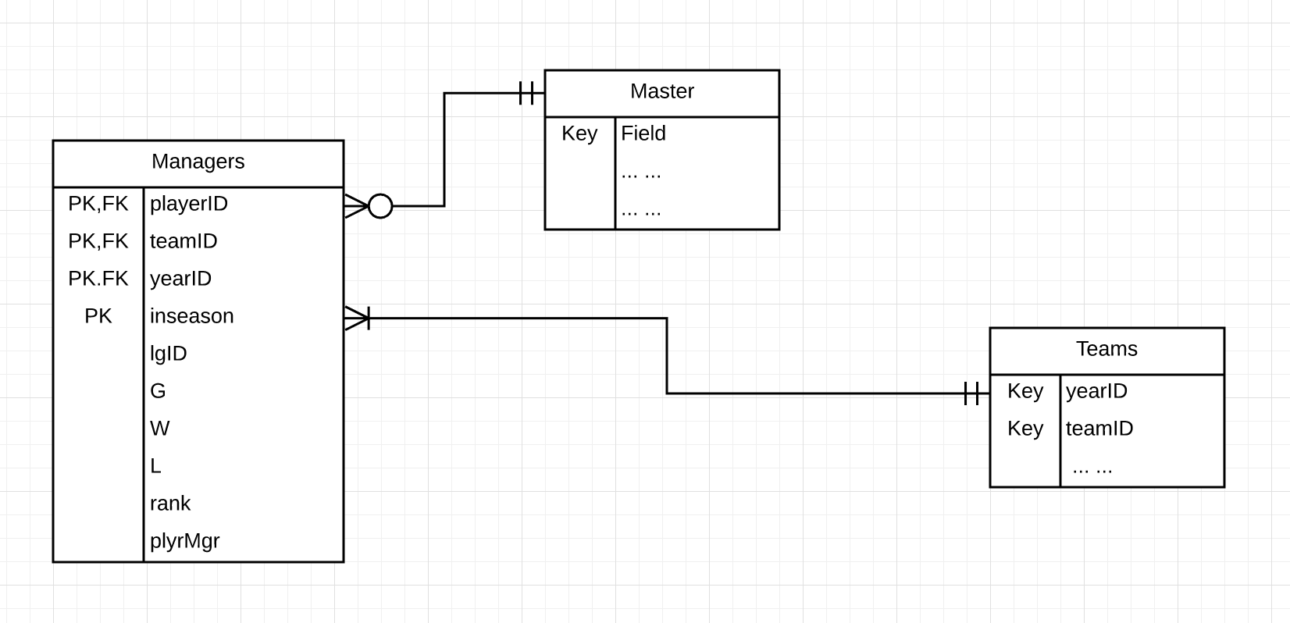
Master is

Slide 10
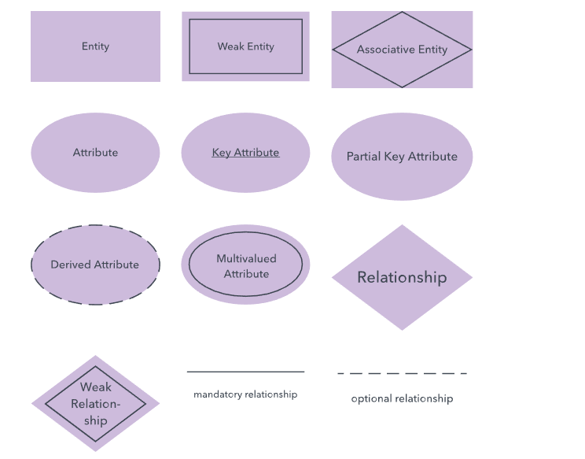
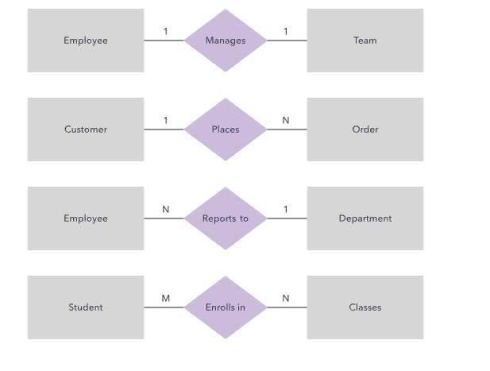

Slide 11
UML relationship types.
Relatively easy to model because the entity schema and data are linked only by foreign keys.
A course section uses a classroom.
A course section has a student.
A student’s calendar owns appointments.
More complex to model because the entity schema and instance data are deeply related.
A student is a person.
A professor realizes course instructor

Slide 13
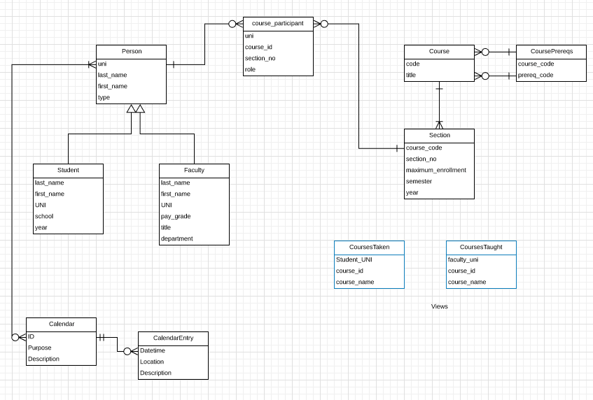
Associative
Entity
Weak
Entity

Slide 14
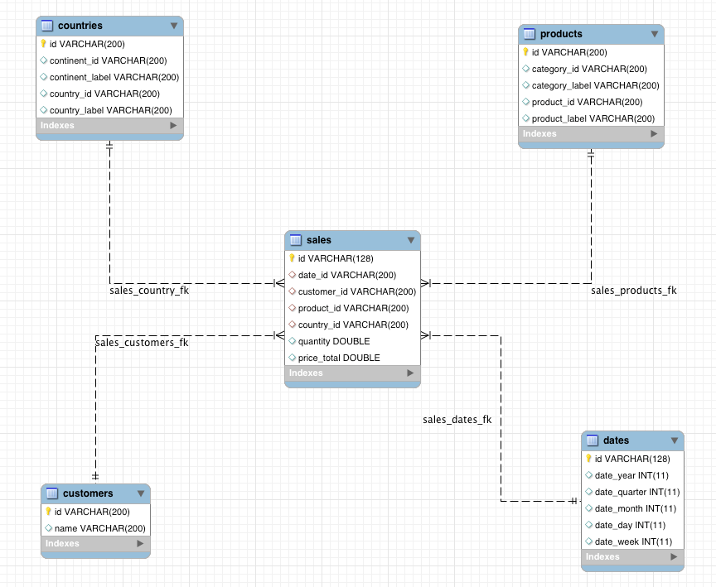
Dimensions
Facts

Slide 15
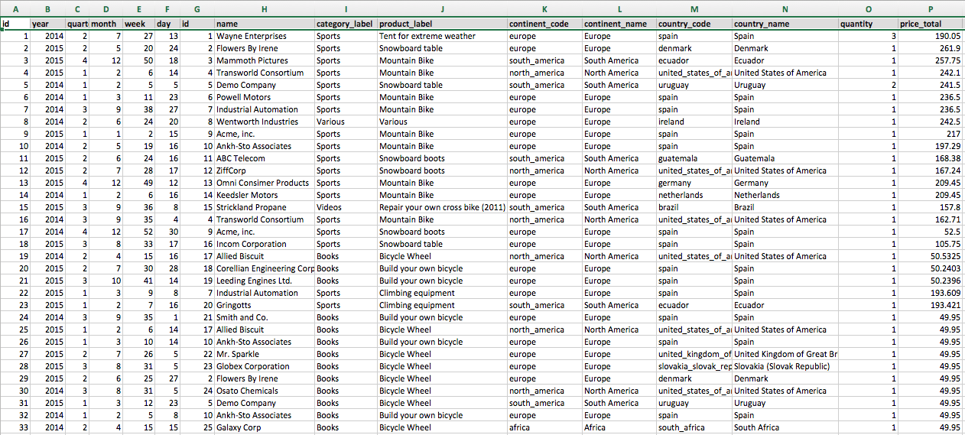
Dimensions
Time Customer. Category Geo Measures

Slide 18
Decision Support
Analysis, Insight
OLTP

Slide 19
